Slide 1



AtliQ Hardware
Finance & supply chain analysis

Slide 2
Project Objective:
This project focuses on analyzing and deriving actionable insights from a comprehensive database provided by AtliQ Hardware. The dataset encompasses key information related to sales, products, customers, and regional performance. The primary objective is to address targeted business questions concerning sales reporting, market trends, customer behavior patterns, and supply chain forecasting. Through this analysis, the project aims to support data-driven decision-making and contribute to strategic planning across various business functions.
Problem Statement:
Due to the growing size of Excel files, AtliQ Hardware has been facing significant performance challenges, including system slowdowns and inefficiencies. To address this, the company has initiated a strategic project aimed at streamlining data operations. A dedicated team of data analysts has been assembled to transition from traditional Excel-based workflows to a more robust and scalable solution using MySQL as the primary database management system. By leveraging SQL queries to extract and analyze key insights from large datasets, the team aims to support informed decision-making, improve operational efficiency, and drive better business outcomes across the organization.

Slide 3
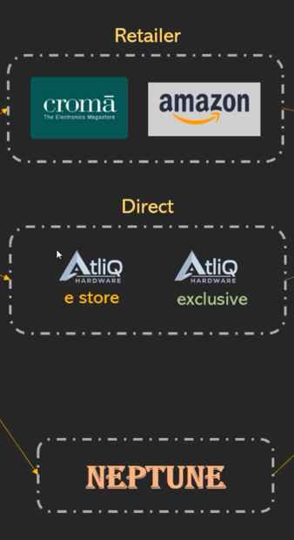
AtliQ Business Model
Customer Platforms
Brick and Mortar
E-Commerce
Croma
Best Buy
Amazon
Flipkart

Slide 4
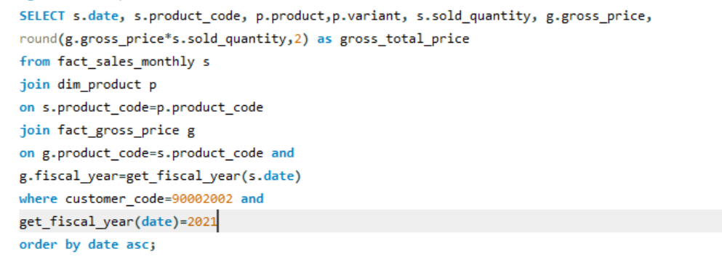
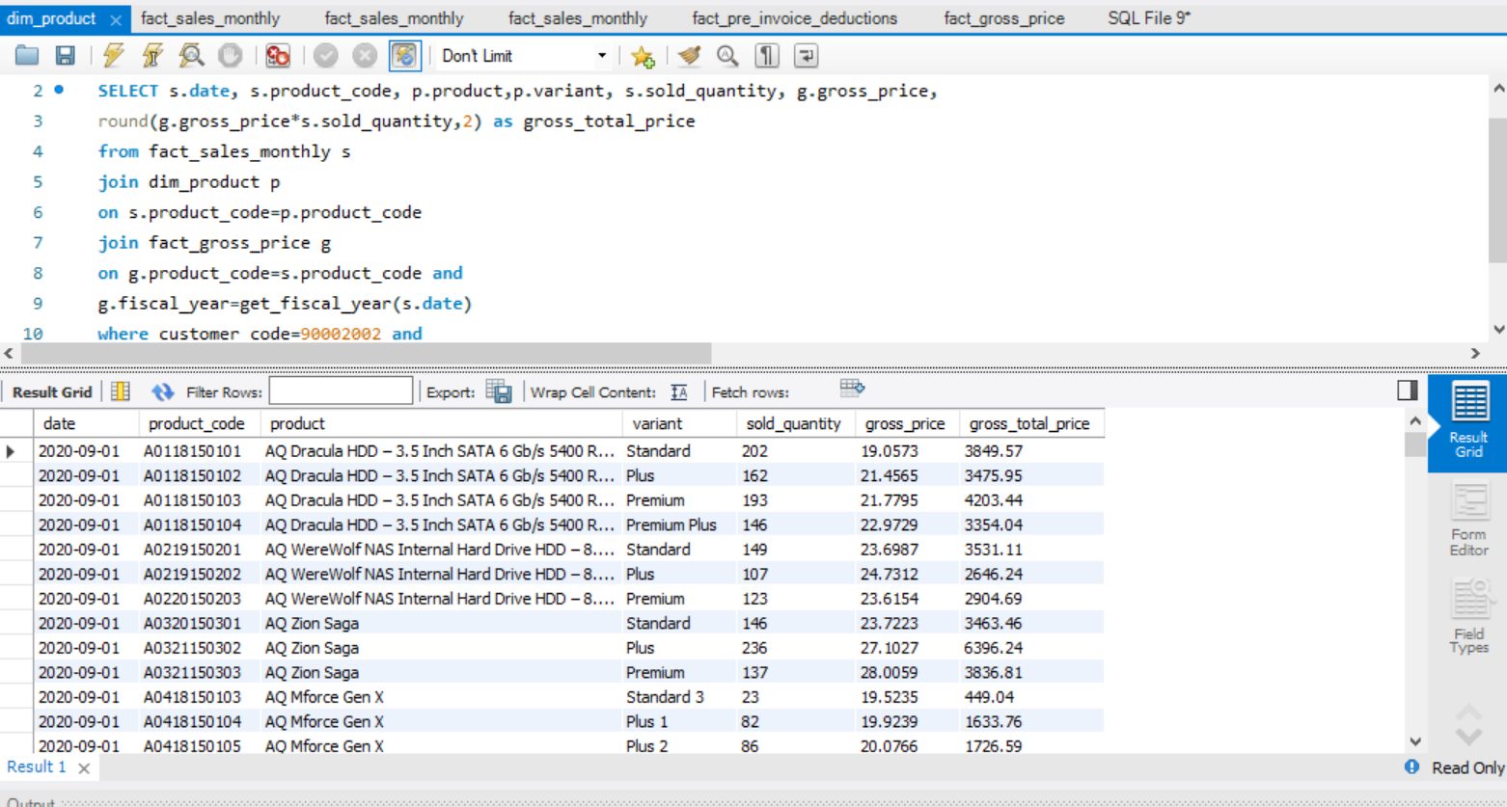
Gross total sales by customer code for fiscal year 2021:

Slide 5
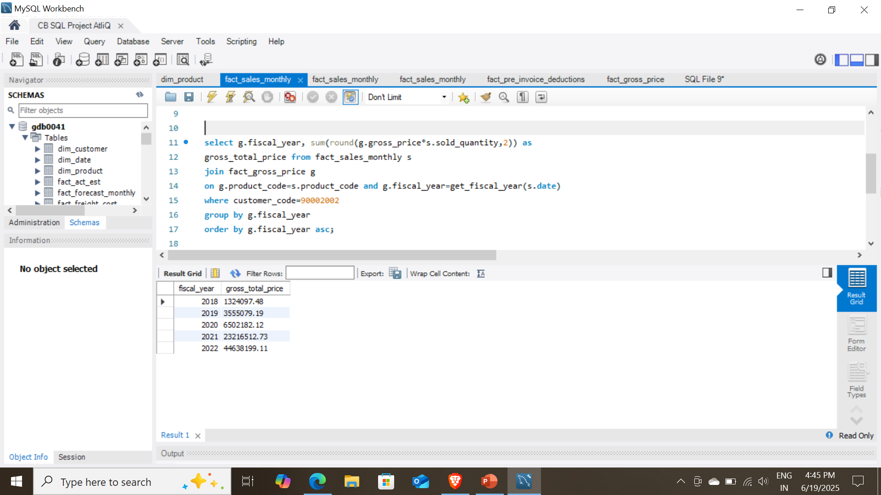
Total gross sales by customer code for each fiscal year:

Slide 6
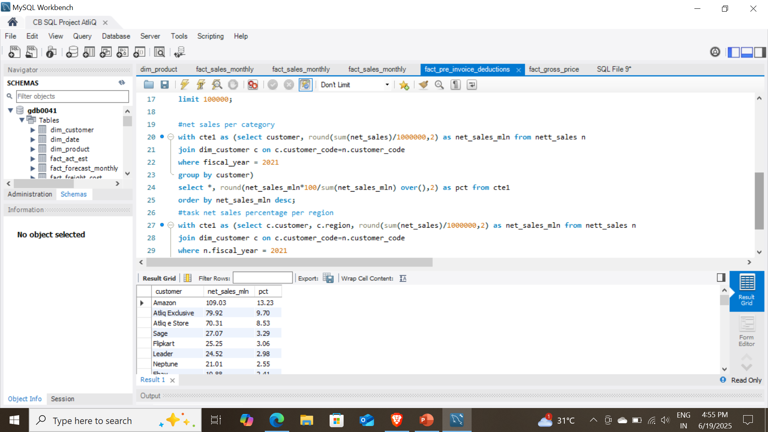
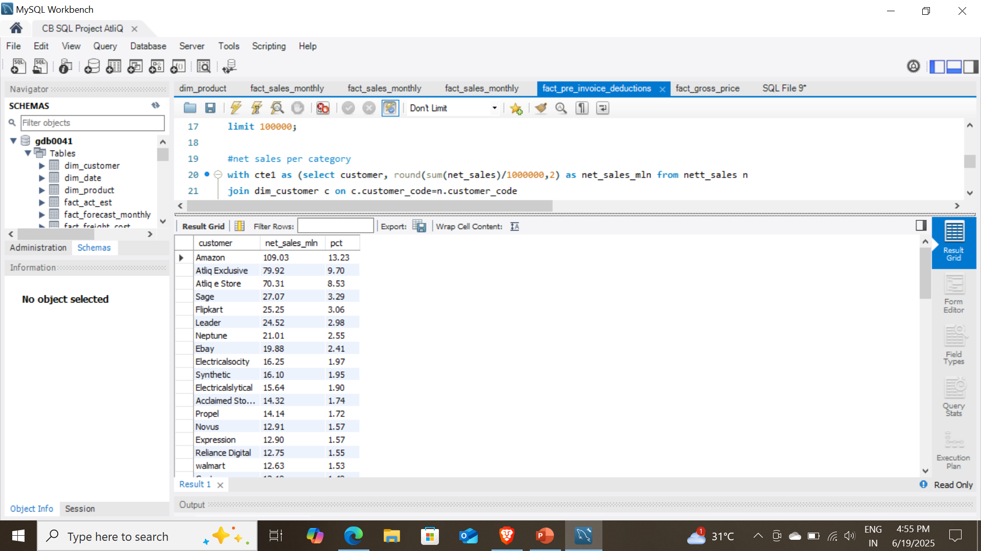
Net sales % by customer and fiscal year:

Slide 7
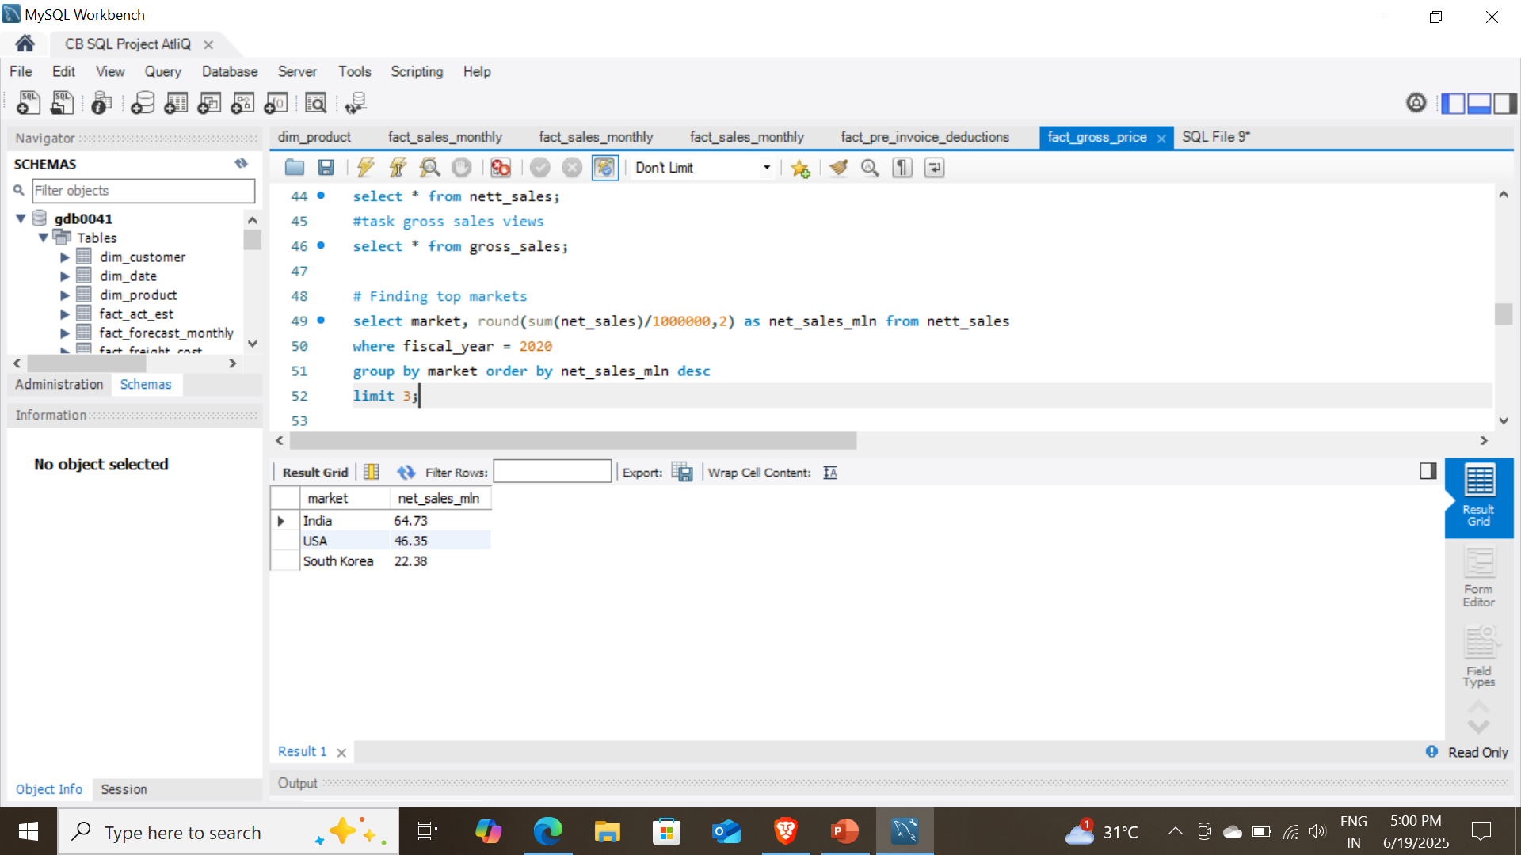
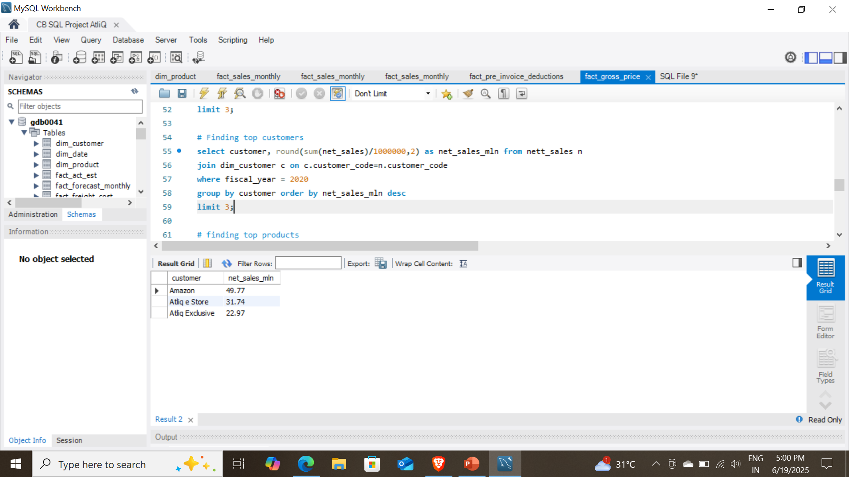
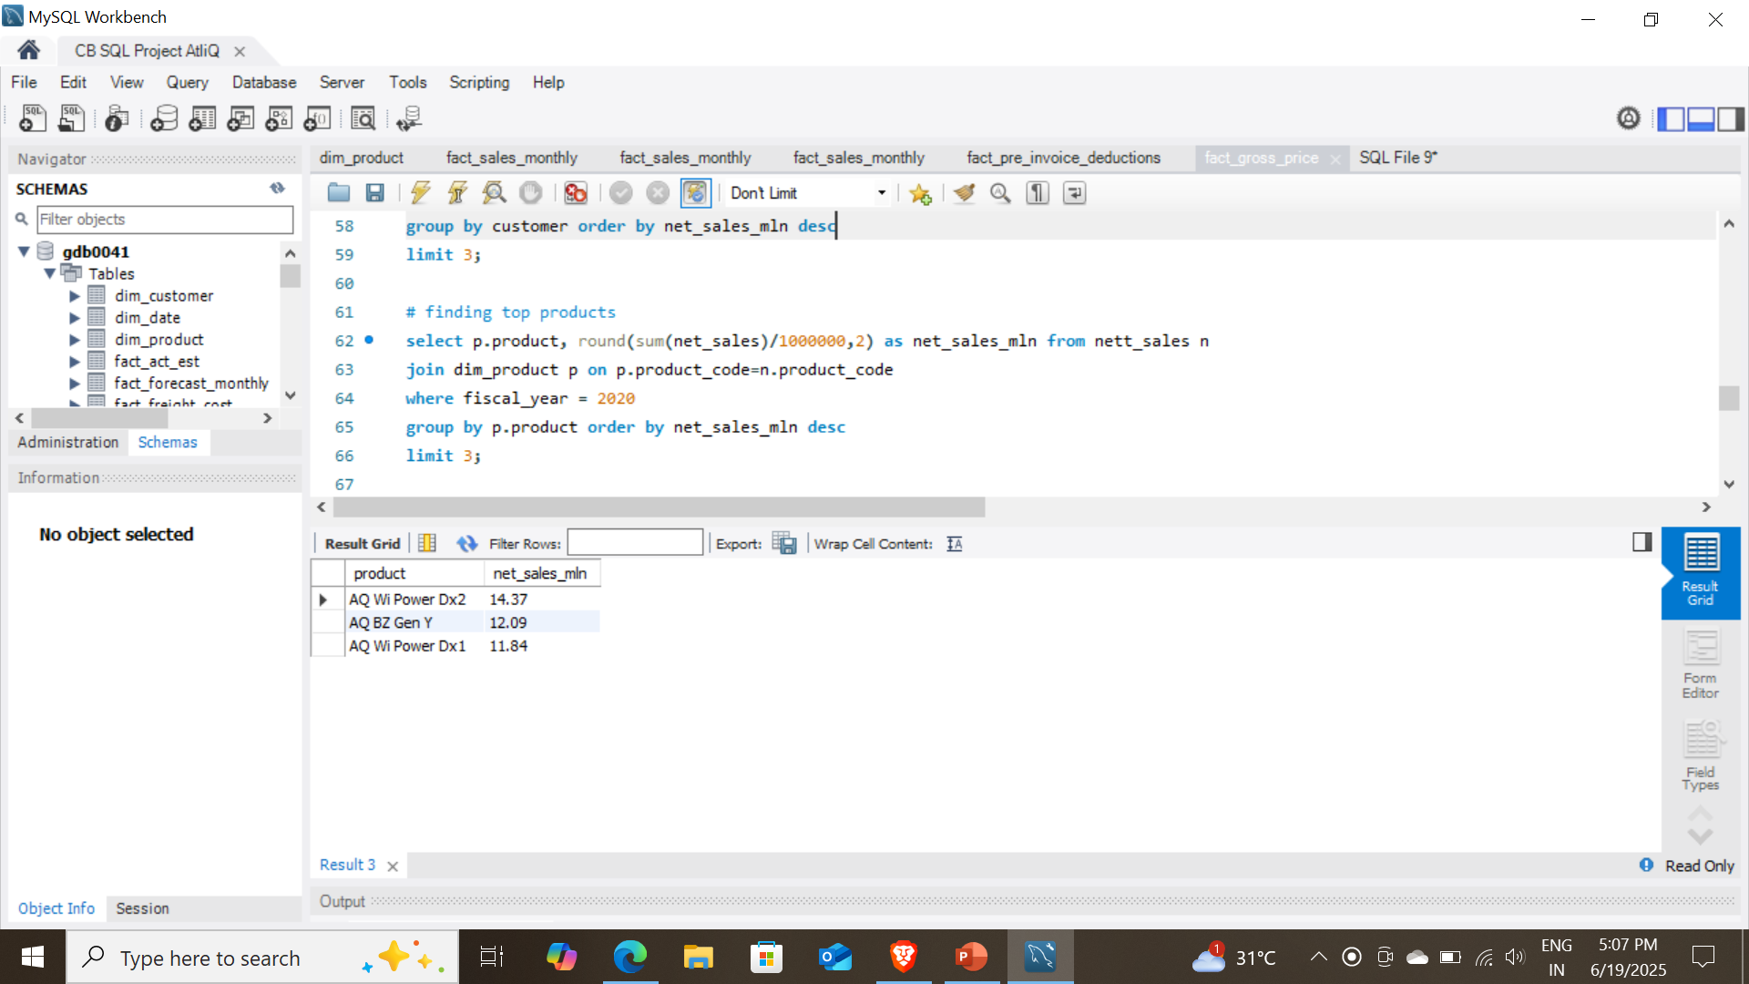
Finding top 3 markets by net sales and fiscal year:
Finding top 3 customers by net sales and fiscal year:
Finding top 3 products by net sales and fiscal year:

Slide 8
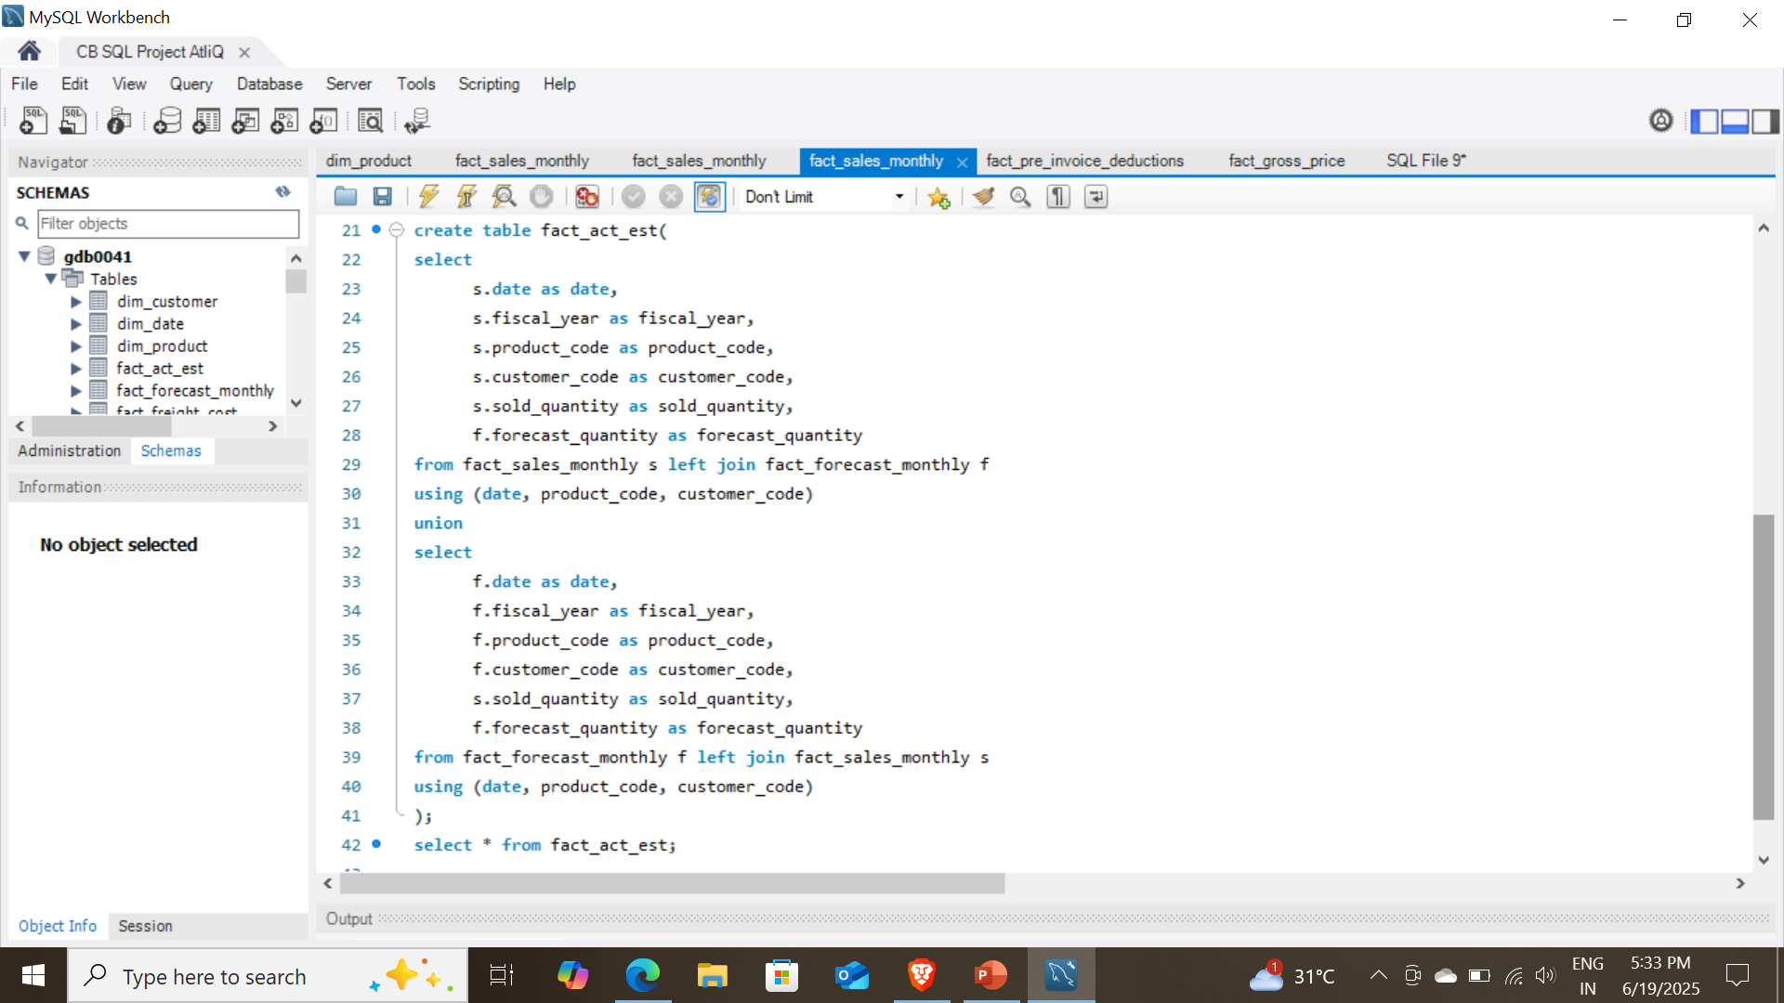
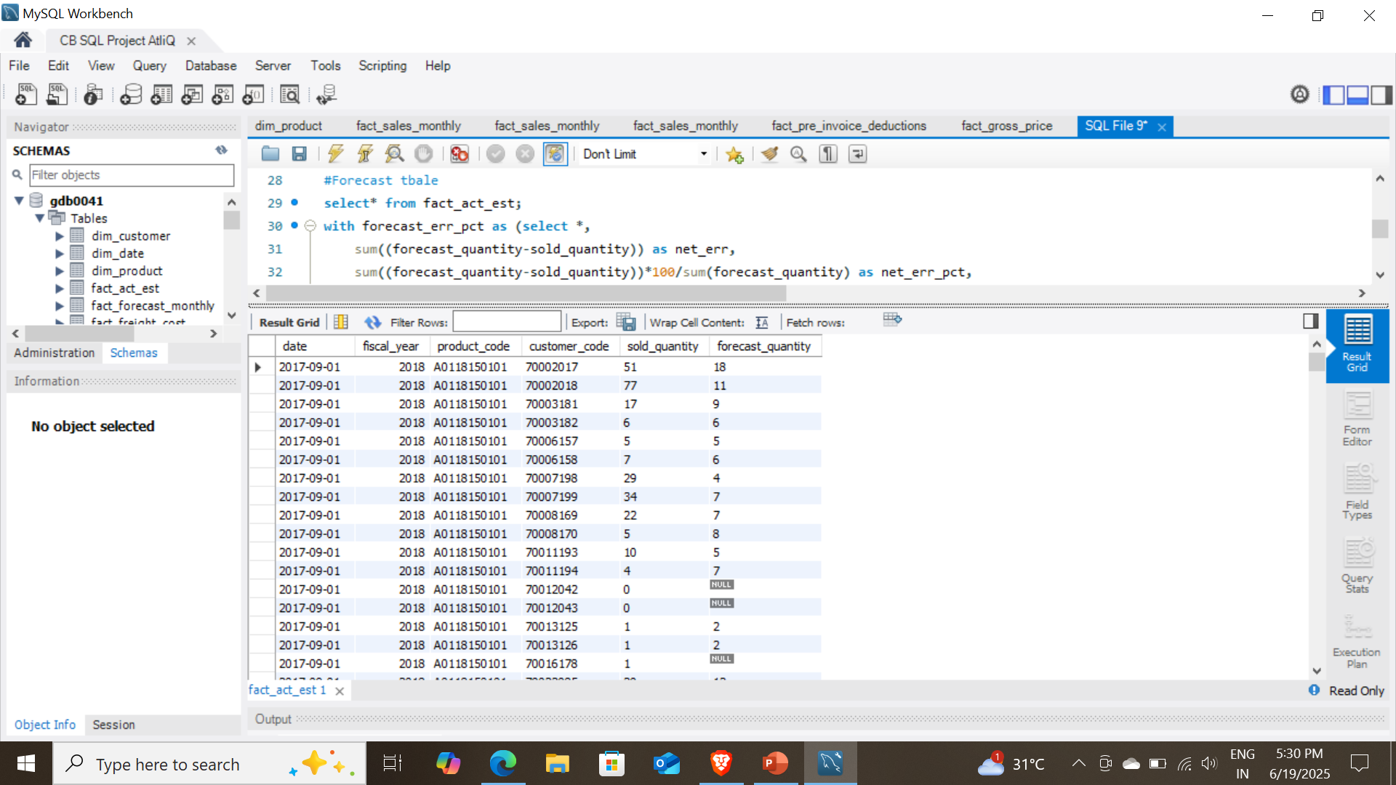
Supply chain analysis – Finding Forecast Accuracy by creating a helper table & TRIGGERS

Slide 9
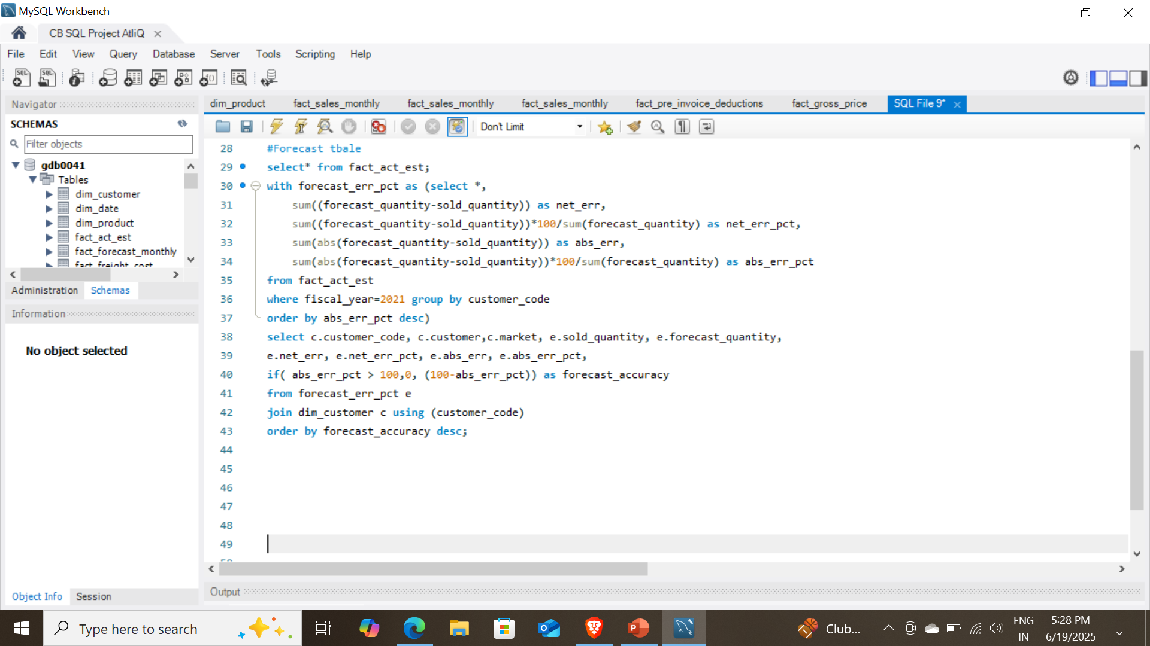
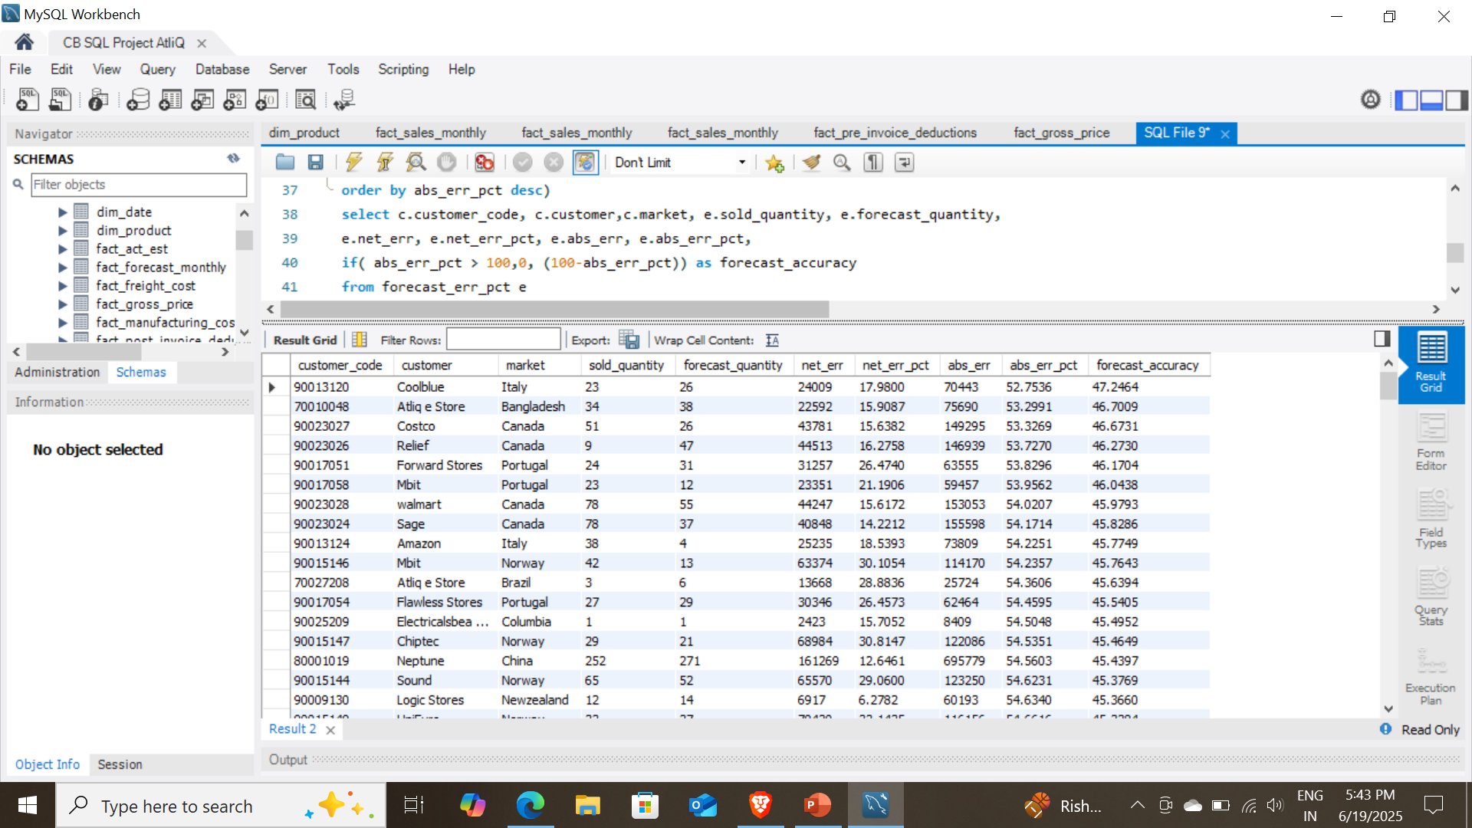
Supply chain analysis - Finding Forecast Accuracy:

Slide 10
Key Insights
Amazon recorded the highest net sales in fiscal year 2021, totaling $109.03 million, followed by AtliQ Exclusive with $79.92 million.
The Indian market generated the highest net sales, reaching $210.67 million in FY 2021, followed by the USA with $132.05 million.
Amazon contributed approximately 13.23% of the total net sales across all customers in FY 2021.
Within the APAC region, Amazon accounted for the highest share of net sales, contributing 12.99% among all customers in 2021.
In the APAC region, India ranked first in terms of total gross sales for the year 2021.

Slide 11
Thank You

